Slide 1
Insert Short PICOST title
Total of 7 (no studies) to 15 slides (maximum) using standard format.
Total presentation time 15 mins. Almost all information should be able to be cut and pasted from SR. Please delete these text boxes when not needed anymore.
Domain lead: Name and #COI
Content Experts: Names and #COI
Taskforce: Name
Essential slide. Estimated presentation time 20 sec

Slide 2
Process
Please state whether KSU (who?), ESR (who?) or Task Force based SR
Was topic reviewed previously? Yes/No
If yes, what year(s)
Existing CoSTR: Yes/No Year
Essential slide. Estimated time <30 sec

Slide 3
PICOST
Population:
Intervention:
Comparison:
Outcomes:
Study Design:
Timeframe:
Essential slide. Paste from PICOST. Estimated time <30 sec

Slide 4
Inclusion/Exclusion & Articles Found
List Inclusion/Exclusion Criteria including dates searched
Insert Number of Articles Found on Search
Insert Number of Articles Finally Evaluated
Essential slide. Paste (as picture or text) from SR. Estimated time <30 sec

Slide 5
Risk of Bias in RCTS
Essential slide(s).
Paste summary of bias assessments here (estimated time 30 sec).
If no RCTs: state no RCTs identified
Paste from SR.

Slide 6
Risk of Bias in nonRCTS
Essential slide(s).
Paste summary of bias assessments here (estimated time 30 sec).
If no nonRCTs included: state no nonRCTs included
Paste from SR.

Slide 7
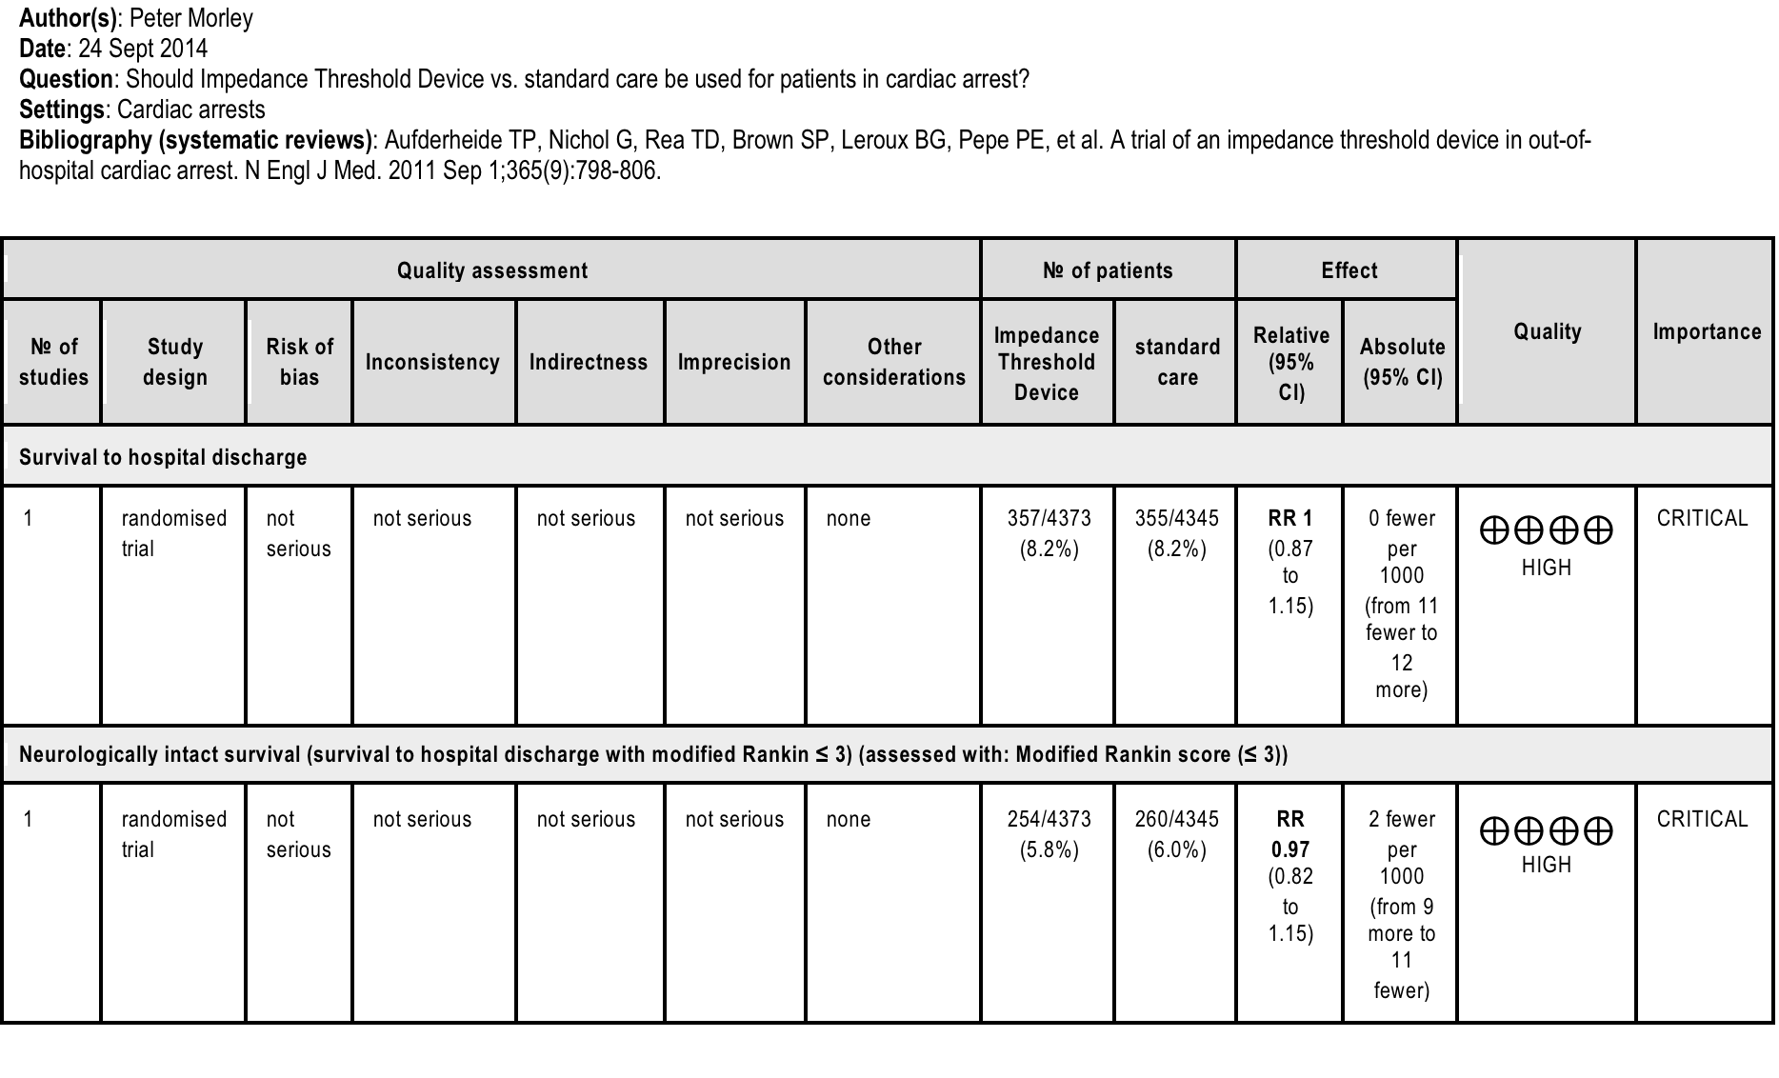
Evidence profile table(s)
Essential slide. Estimated time <60 sec.
One of up to 3 (maximum) Evidence Profile slides (in standard format) for all outcomes designated as “critical”. May refer to more than one question per slide if necessary. Could be pasted from word, gradepro.org or SR.

Slide 8
Proposed Consensus on Science statements
Insert Summary statement(s) from SR
For the important outcome of “survival to hospital discharge” we have identified moderate quality evidence (downgraded for indirectness) from two RCTs enrolling 421 patients showing no benefit (OR 0.81 95% CI 0.33 – 2.01).
We did not identify any evidence to address the critical outcome of “neurologically intact survival”.
Essential slide (minimum of one slide). Estimated time <60 sec. Insert Summary statement(s) from SR.

Slide 9
Draft Treatment Recommendations
Insert draft Treatment Recommendations
(including direction, strength of evidence grade and quality of evidence): eg.
We recommend against X in comparison to Y for OHCA (strong recommendation, high quality of evidence). Values and preferences statement: In making this recommendation we place a higher value on not allocating resources to an ineffective intervention over any yet to be proven benefit for critical or important outcomes.
For weak recommendation would use the word “suggest” instead of “recommend”.
Recommendations can obviously be for or against routine or specific use.
Essential slide (one or two slides only). Estimated time <60 sec.
Insert draft Treatment recommendations from SR team.

Slide 10
Knowledge Gaps (eg. ETT vs BVM)
Other specific PICOs that would be helpful
Relationship with training to ETT success
Specific research required
in-hospital airway studies
Essential slide (one slide only). Estimated time <30 sec

