Slide 1
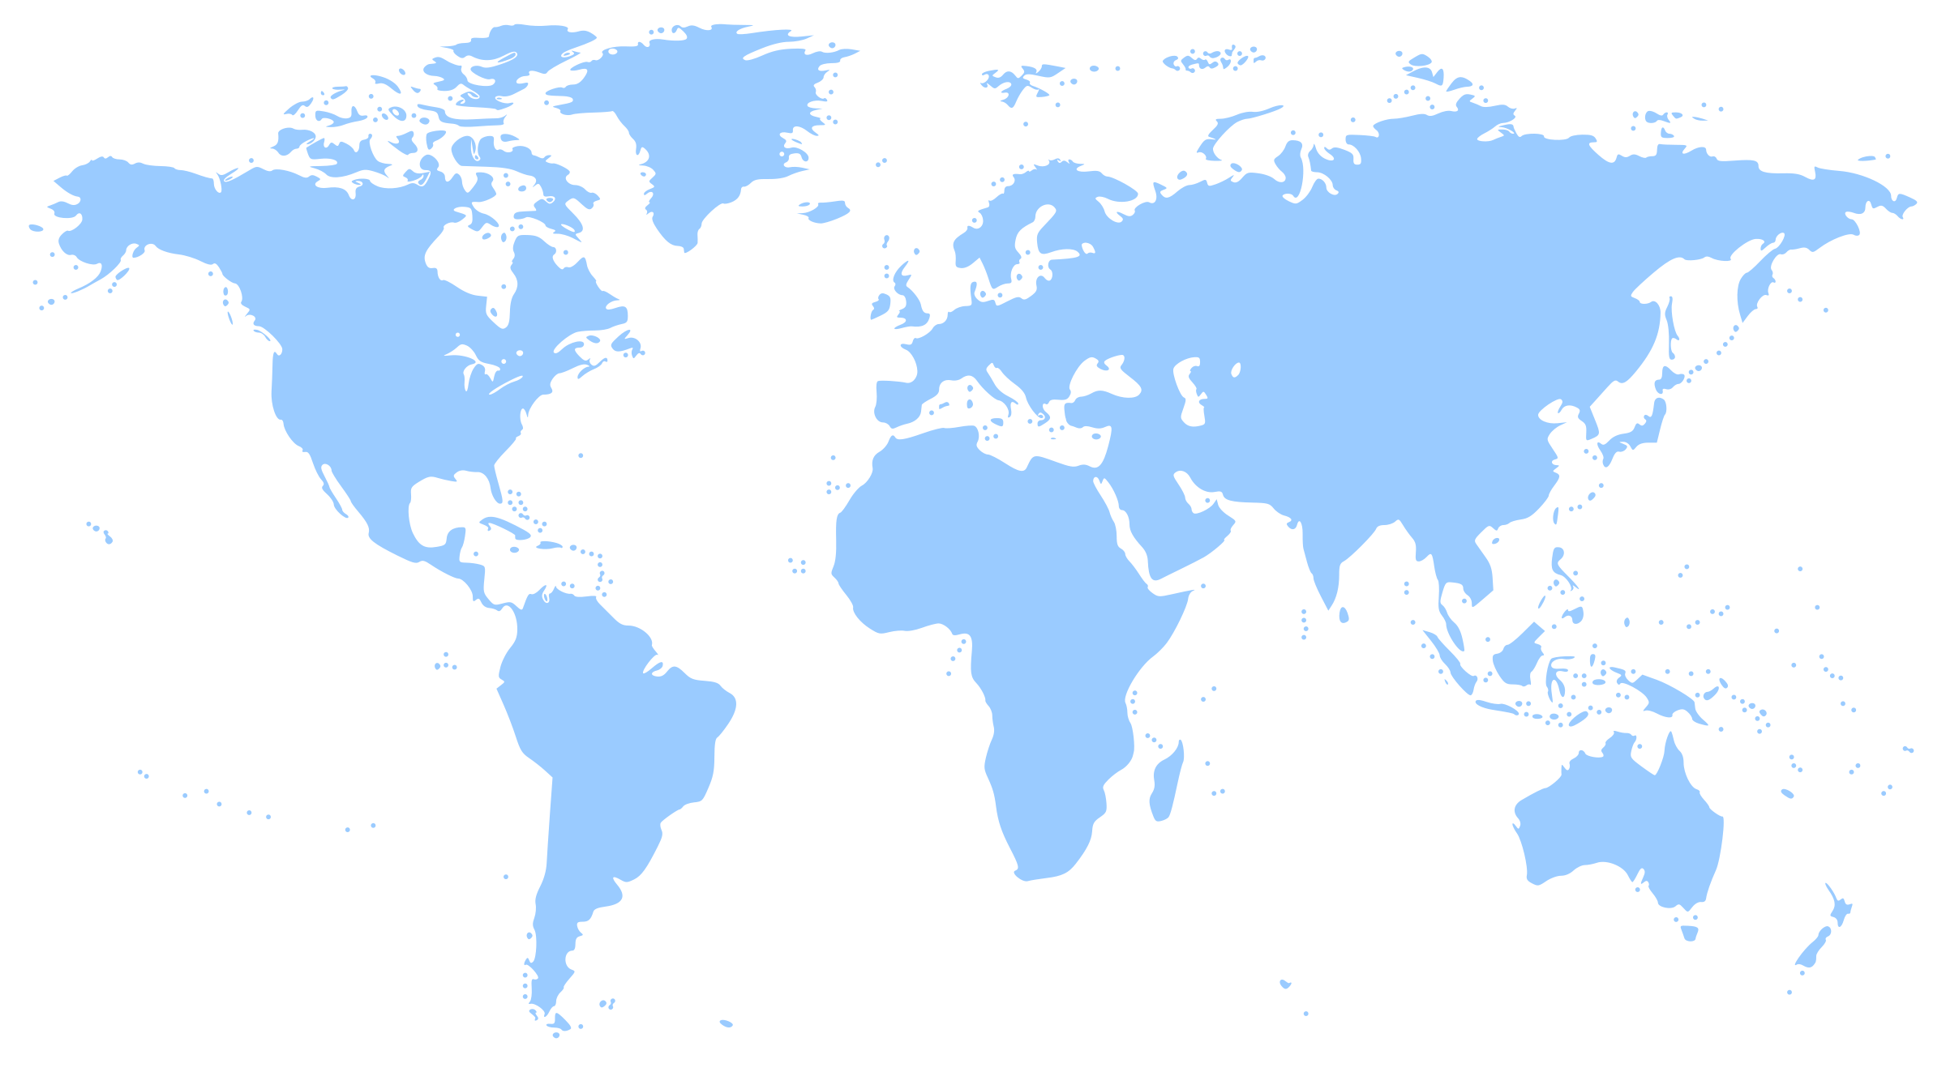
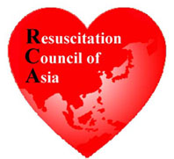
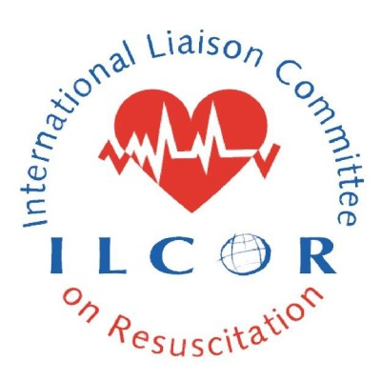
Notes:
Optional slide in case description of ILCOR needed
ILCOR = International Liaison Committee on Resuscitation
Comprises 7 regional councils:
Heart & Stroke Foundation of Canada
American Heart Association
InterAmerican Heart Foundation
European Resuscitation Council
Resuscitation Council of Southern Africa
Resuscitation Council of Asia
Australian and New Zealand Committee on Resuscitation

Slide 2
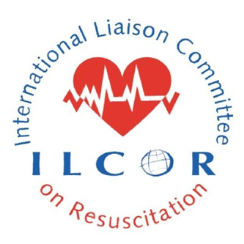
World Restart a Heart
Bystander CPR associated with better outcomes
Global lay bystander CPR rates vary significantly 5-80%
Bystanders witness collapse >50% cases
Countries with higher bystander CPR rates have better survival rates

Slide 3
World Restart a Heart
“Save more lives globally through resuscitation”
WRAH Primary Goals
Increase cardiac arrest awareness
Increase bystander CPR rates worldwide

Slide 4
World Restart a Heart
“Save more lives globally through resuscitation”
On or around 16 October 2018
Global engagement
Not limited to teaching children

Slide 5
World Restart a Heart
“All Citizens of the World can Save a Life!”
#worldrestartaheart
www.ilcor.org/wrah
CALL TO ACTION
Contact your regional council to help make WRAH 2018 a success!

